Slide 1


Slide 2
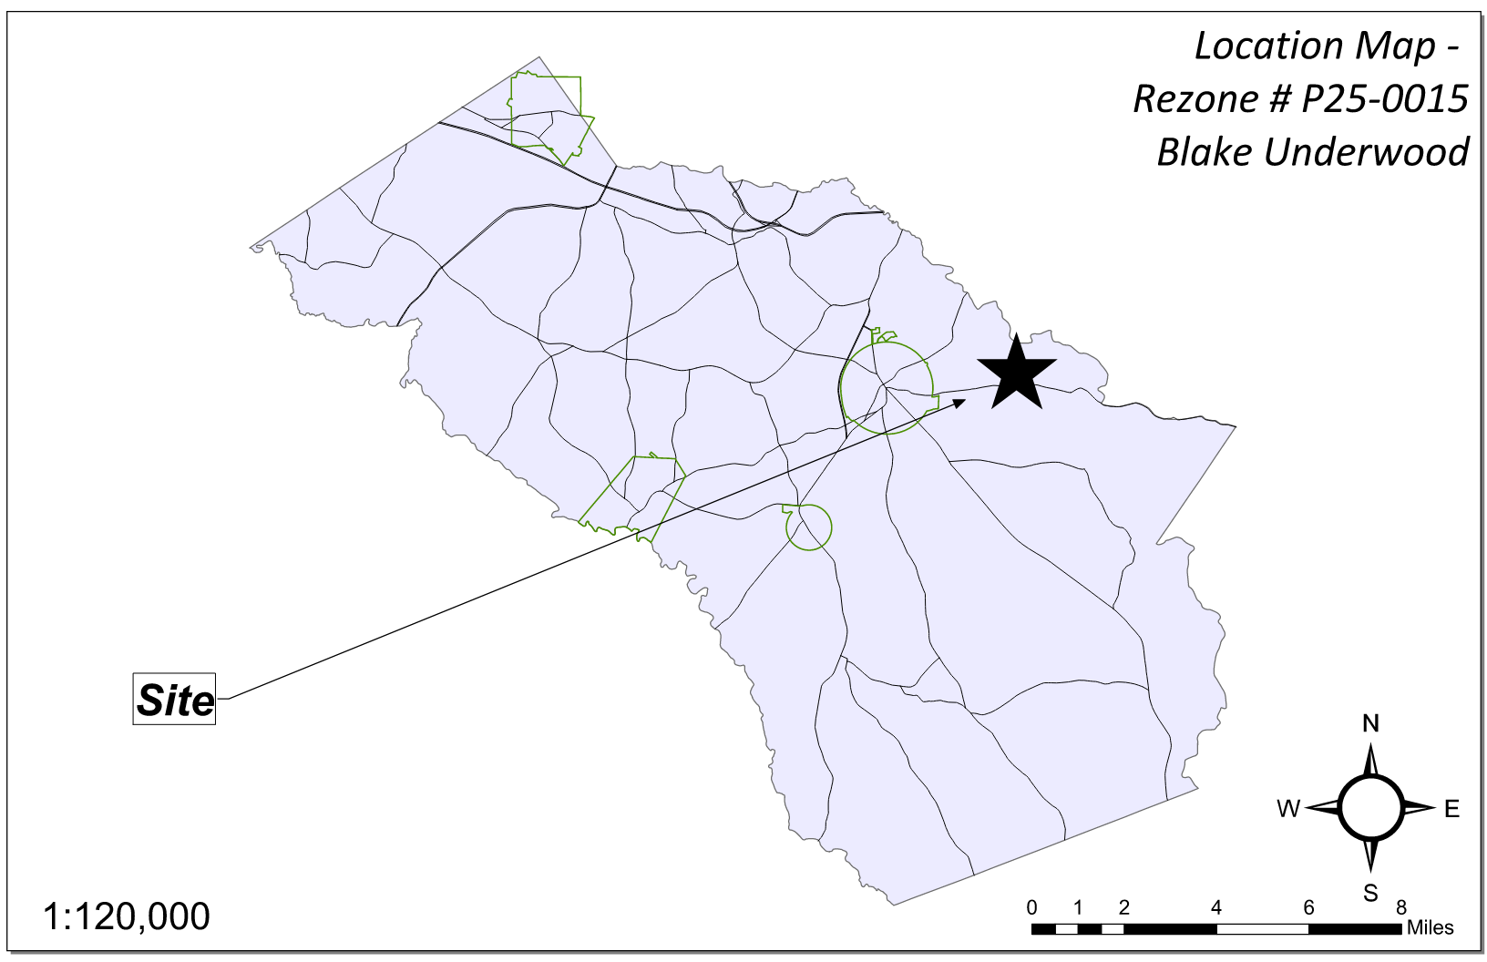
Site Location

Slide 3
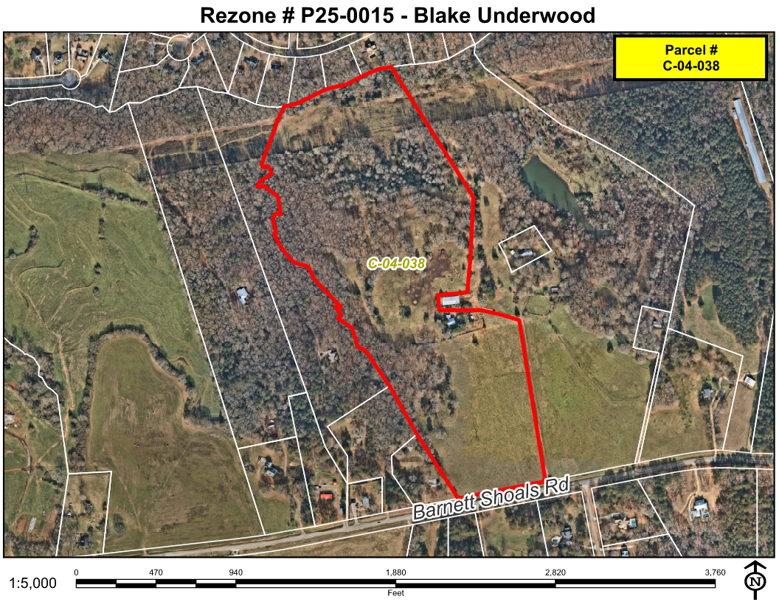
Aerial Imagery

Slide 4
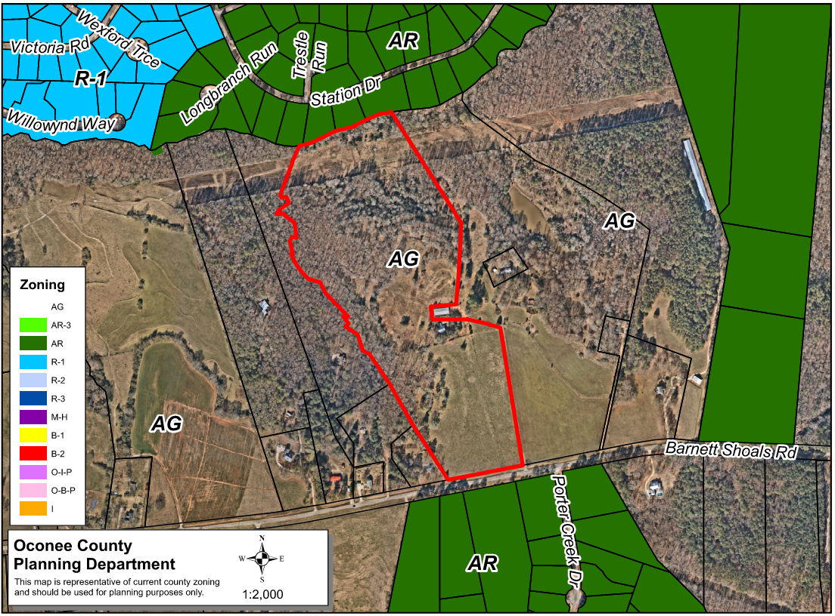
Zoning
AG

Slide 5
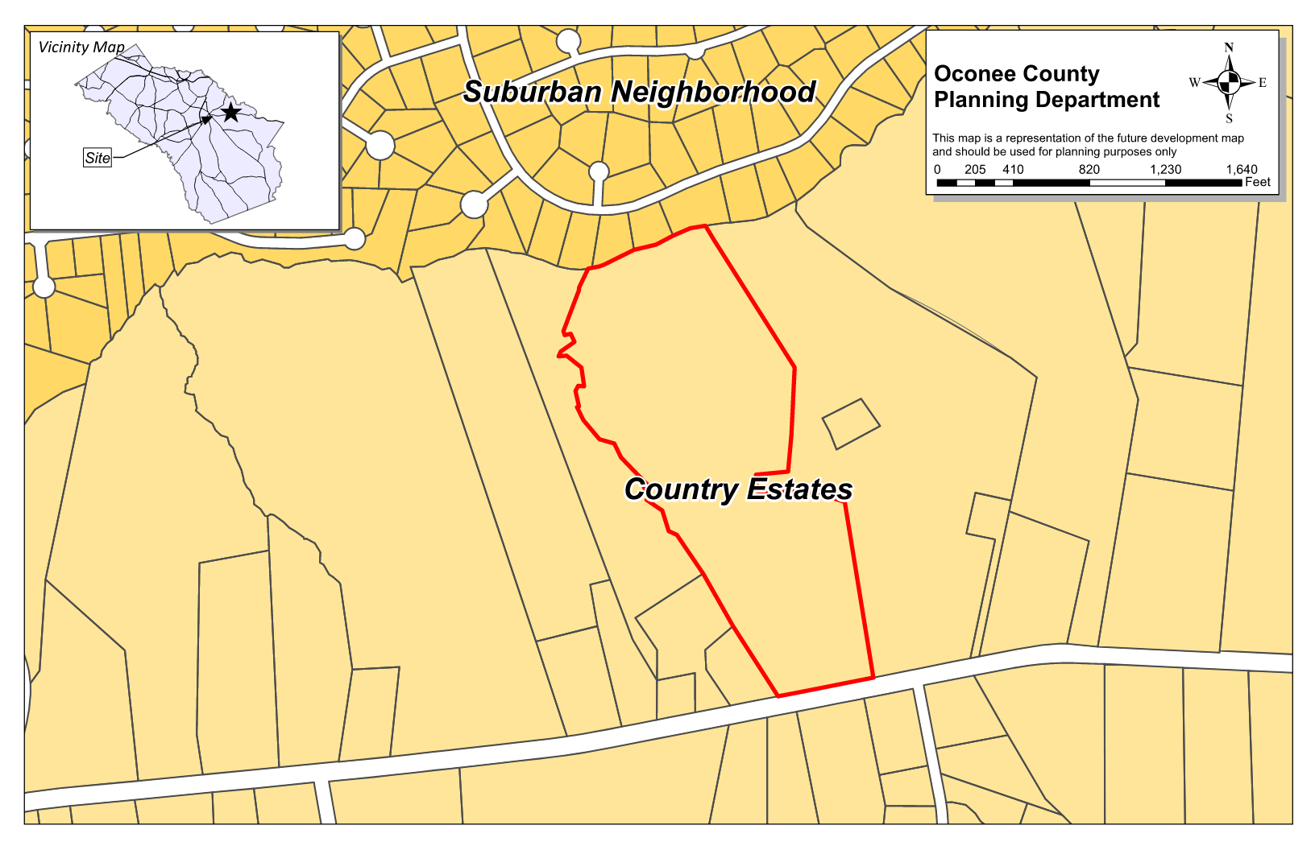
Future Development

Slide 6
Summary of Request
Rezone the ±48.96 acre property from AG (Agricultural) to AR (Agricultural Residential)

Slide 7
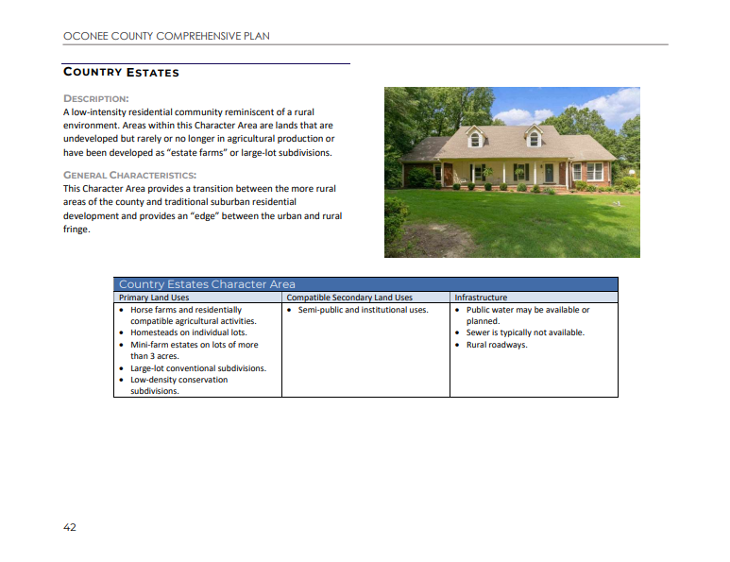
Comprehensive Plan Designation

Slide 8
Comprehensive Plan Designation

Slide 9
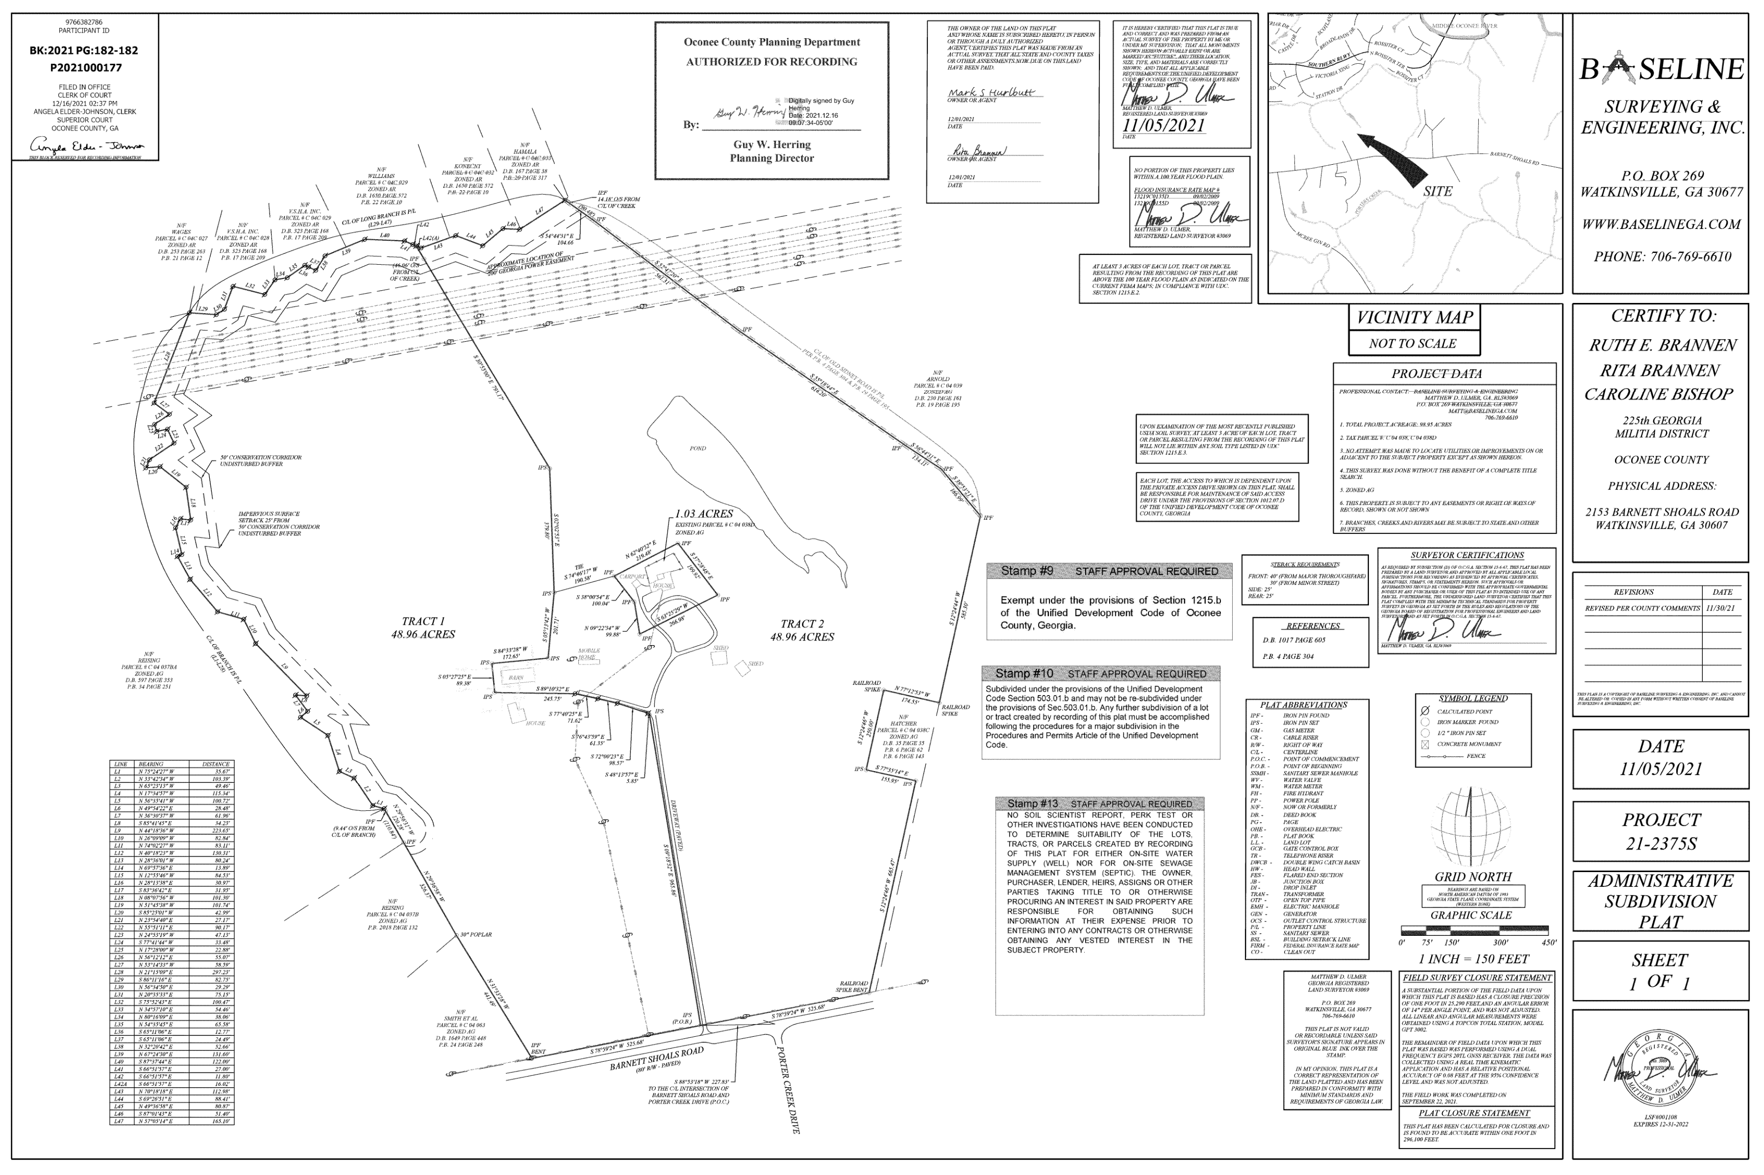
Recorded Plat

Slide 10
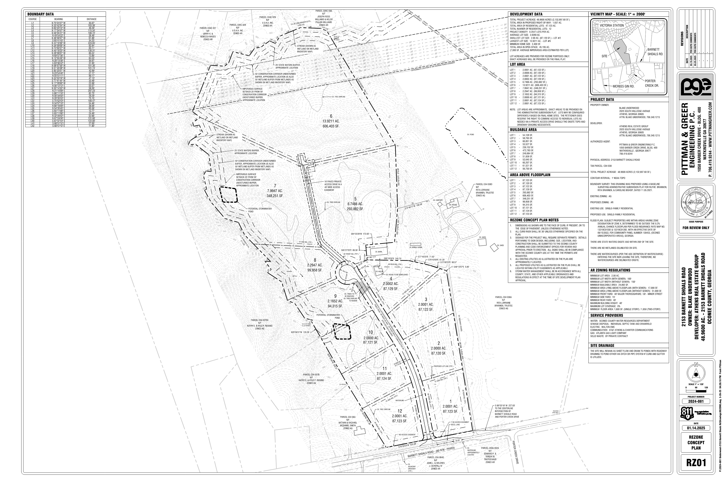
Concept Plan

Slide 11
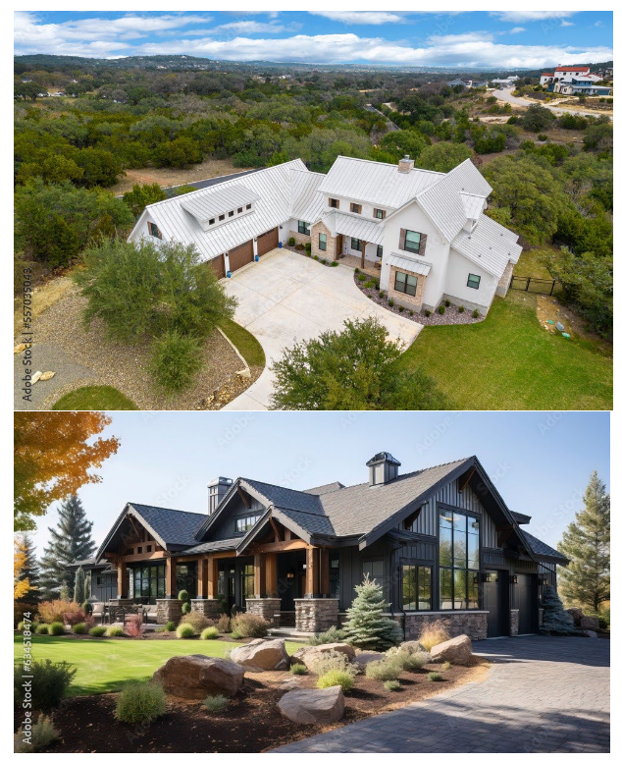
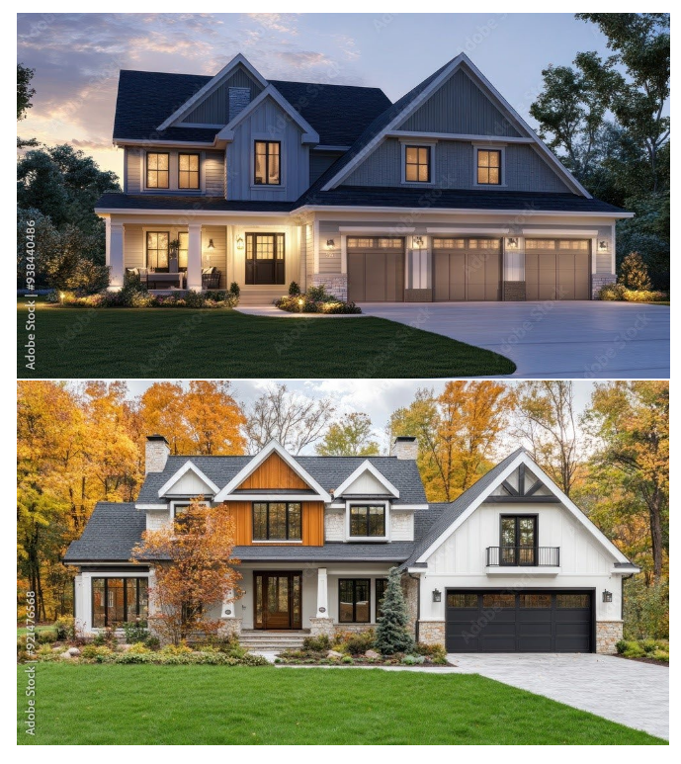
Architectural Images

Slide 12
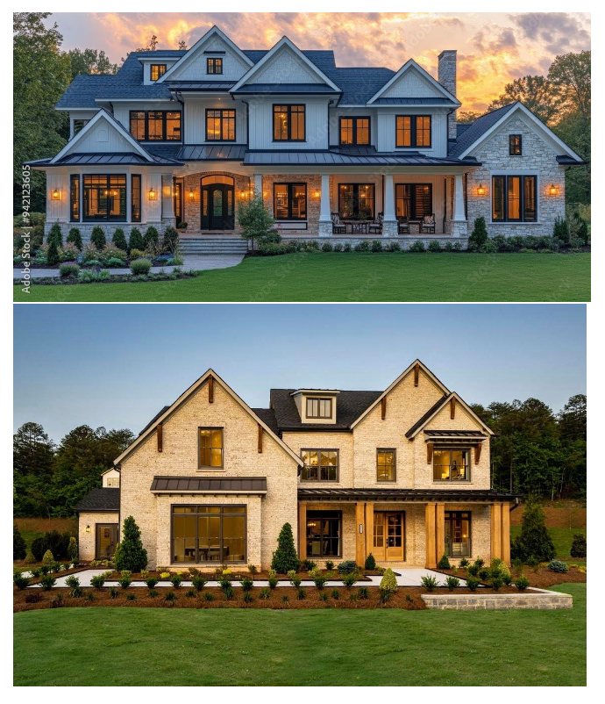
Architectural Images

Slide 13
Staff Recommendation
Based on Board of Commissioners policies, decision-making criteria, and standards outlined in the development codes of Oconee County, staff recommends conditional approval of the request to rezone ±48.960 acres to AR-3, but not AR subject to the following conditions to be fulfilled at the expense of the owner/developer:
1. Development design and structures shall meet or exceed the standards indicated on the concept plan, narrative, representative architectural sketches, and other documents submitted with the zoning application and attached hereto. This condition shall not construe approval of any standard that is not in conformity with the Unified Development Code.
2. The owner at their own expense shall construct the improvements required by the County for public water for the subject property and shall convey the same to the County, free of all liens. Said improvements shall include all on-site improvements and such off-site improvements as are required by the County to provide service to subject property.
3. At its expense, Owner shall make all right of way improvements and shall dedicate all rights of way which are required by the County after the County’s review of Owner's development plans pursuant to the County’s ordinances and regulations. All such improvements shall be shown on the preliminary site plan and site development plans for the project and no development permit shall be issued until Owner has agreed to such improvements and dedication.
4. Stormwater ponds shall be placed on a separate utility lot or lots having a minimum road frontage of 40 feet.
5. A preliminary plat shall be submitted for review indicating all lots meet the minimum requirements of the AR-3 zoning district. The preliminary plat submission shall be in lieu of a revised concept plan to meet the requirements of section 1206.05.d.2.

Slide 14
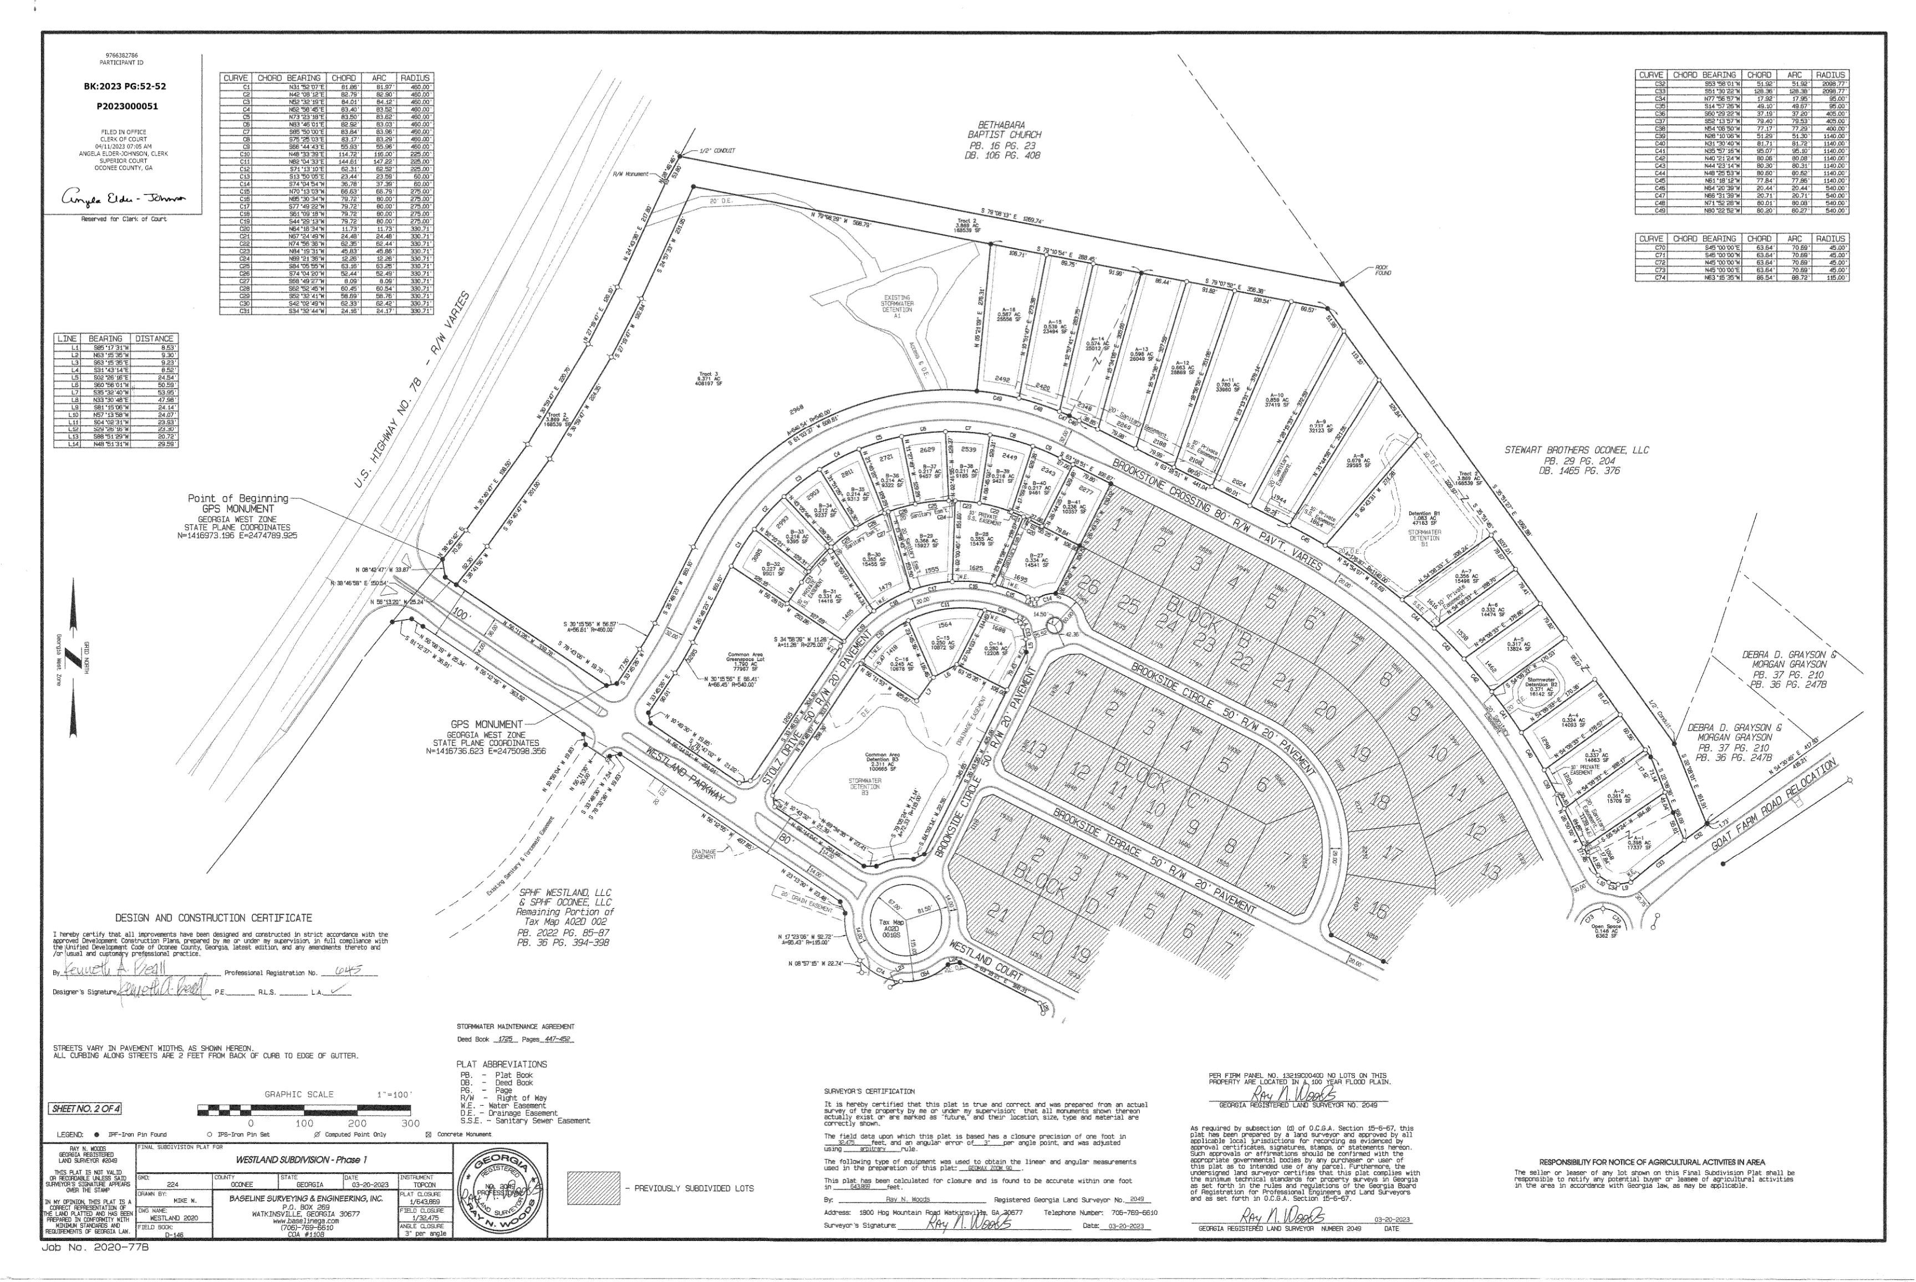
Example of Required Utility Lot for Detention Pond

Slide 15
Planning Commission Recommendation
Planning Commission recommends approval subject to the AR-3 zoning and conditions recommended by staff.

